Slide 1
Flow Control Instructions

Slide 2
Why Flow Control
To control the sequential flow of the algorithm
Change the sequence of execution based on some defined criteria on run-time
Keep track of logical sequence of the program
Keep check on the outputs of various instructions i.e what will happen if user inputs wrong value
Managing the program exceptions
Providing user with multiple flows based on the input or value of selection

Slide 3
JUMP & Loops
Jump and Loop instructions transfer control to another part of the program
Transfer can be unconditional or can depend on a particular combination of status flags
Jump allows programmer to skip program sections and branch to any part of memory for the next instruction.
A conditional jump instruction allows decisions based upon numerical tests.
results are held in the flag bits, then tested by conditional jump instructions
LOOP and conditional LOOP are also forms of the jump instruction

Slide 4
JUMP & Loops
Control flow instructions depend largely on Flag registers
Need to be careful of flag values while using control flow instructions such as LOOP, JUMP etc
Some of the examples of Loops are
JNZ = Jump not Zero (CX & Zero Flag)
JG = Jump if greater (ZF)
JL = Jump if less ( SF and OF)

Slide 5
Example
. MODEL SMALL
.STACK 100H
.DATA
PROMPT DB 'The 256 ASCII Characters are : $'
.CODE
MAIN PROC
MOV AX, @DATA ; initialize DS
MOV DS, AX
LEA DX, PROMPT ; load and print PROMPT
MOV AH, 9
INT 21H

Slide 6
Example
MOV CX, 256 ; initialize CX
MOV AH, 2 ; set output function
MOV DL, 0 ; initialize DL with first ASCII character
PRINT_LOOP: ; loop label
INT 21H ; print ASCII character
INC DL ; increment DL to next ASCII character
DEC CX ; decrement CX
JNZ PRINT_LOOP ; jump to label @ PRINT_LOOP if CX is not 0
MOV AH, 4CH ; return control to DOS
INT 21H
MAIN ENDP
END MAIN

Slide 7
How CPU Implements Conditional Jump
CPU looks at the FLAGS register.
It reflects the result of the last thing the processor did.
If the condition for the jump (expressed as a combination of status flag settings) are true.
CPU adjusts the IP to point to the destination label. so that the instruction at this label will be done next.

Slide 8
How CPU Implements Conditional Jump
If the jump condition is false, then IP is not altered and the next instruction in line will be done.
In the preceding program, the CPU executes JNZ PRlNT_LOOP by inspecting ZF.
If ZF = 0, control transfers to PRINT_LOOP
if ZF = 1, the program goes on to execute MOV AH,4CH.

Slide 9
For Loop
LOOP instruction is used to implement a for loop.
LOOP destination_label
The counter for the loop is the CX, initialized to loop_count. Execution of the LOOP Instruction causes CX to be decremented automatically.
if CX is not 0, control transfers to destination_label. If CX is 0, the next instruction after LOOP is done.
For loop is implemented as.
;initialize CX to loop_count
Top:
;body of the loop
LOOP TOP

Slide 10
Example
Write a count-controlled loop to display a row of 80 stars.
MOV CX,80
MOV AH,2
MOV DL,'*'
TOP:
INT 21h
LOOP TOP

Slide 11
Example
Write code to display given numbers.
1 2 3 4 5 6 7 8 9
MOV CX,9
MOV AH,2
MOV AL,0
TOP:
INC AL,
MOV DL,AL
INT 21h
LOOP TOP

Slide 12
For Loop Exercise
Put the sum 1 + 2 + 3+ .. + 8 in AX.
Put the sum 5+ 4 + 3+ .. + 1 in AX.
put the sum of the first 50 terms of the arithmetic sequence 1, 5, 9, 13, ... in DX.
Read a character and display it 80 times on the next line.

Slide 13
Jump Categories
There are three categories.
Signed jumps are used when a signed interpretation is being given to results
Unsigned jumps are used for an unsigned interpretation,
Single-flag Jumps, which operate on settings of individual flags.
jump instructions themselves do not affect the flags.

Slide 14
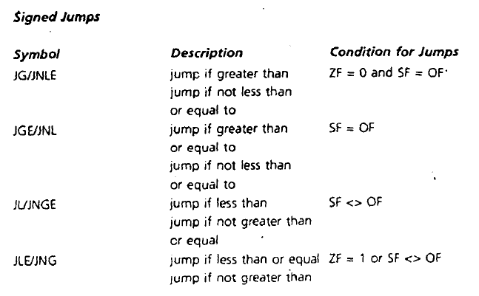
Signed Jumps

Slide 15
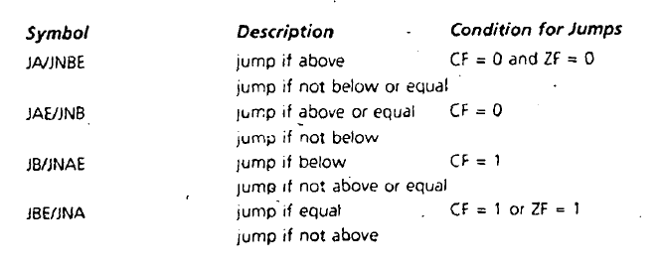
Unsigned Jumps

Slide 16
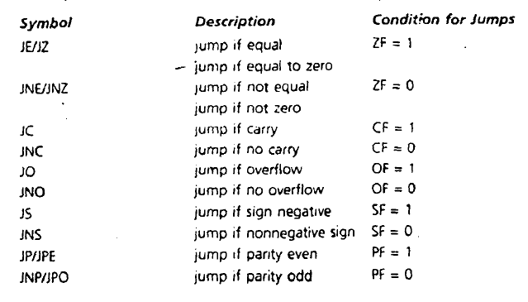
Single flag Jumps

Slide 17
CMP
Compares the two memory locations i.e registers
CMP destination , Source
CMP is like SUB,
Results is not stored in destination but flags are affected
Operands of the CMP instruction may not both be memory locations
Destination may not be a constant

Slide 18
CMP
Suppose a program contains these lines CMP AX,BX
JG BELOW
where AX = 7FFFh, and BX = 0001. The result of CMP AX,BX is 7FFFh -0001h =7FFEh.
jump condition for JG is satisfied, because ZF = SF = OF = 0
So control transfers to label BELOW.

Slide 19
CMP
Suppose a program contains these lines CMP AX,BX
JG BELOW
where AX = 7FFFh, and BX = 0001. The result of CMP AX,BX is 7FFFh -0001h =7FFEh.
jump condition for JG Is satisfied, because ZF = SF = OF = 0
So control transfers to label BELOW.

Slide 20
While loop
Write code to read character until user press enter.
mov al,0
top:
cmp al, 0DH
JE End_Loop
MOV AH,1
INT 21h
JMP top
End_Loop:

Slide 21
Repeat Until Loop
Write code to read characters until a blank is read.
MOV AH,1
REPEAT:
INT 21h
CMP AL,' '
JNE REPEAT

Slide 22
While & Repeat Until Examples
initialize count to 0
read a character
WHILE character <> carriage_return DO
count = count + l
read a character
End_While
REPEAT
read a character
UNTIL character is blank

Slide 23
While & Repeat Until Examples
Write a sequence of instructions to divide AX by BX, and put the quotient in CX.
initialize quotient to 0
WHILE dividend > = divisor DO
increment quotient
subtract divisor from dividend
END_ WHILE
Write a sequence of instructions to multiply AX by BX, and put the product in CX
initialize product to 0
REPEAT
add M to product
decrement N
UNTIL N = 0

Slide 24
Interpreting the Conditional Jumps
It's not necessary for a programmer to think about the flags.
Just use the name of the jump to decide if control transfers to the destination label.
CMP AX, BX
JG BELOW
If AX is greater than BX (in a signed sense), then JG jump if greater than) transfers to BELOW.

Slide 25
Signed Versus Unsigned Jumps
Whether to use a signed or unsigned jump depends on the interpretation being given.
signed jumps operate on ZF, SF, and OF
unsigned jumps operate on ZF and CF.
wrong kind of jump can lead to incorrect results.
Suppose a signed interpretation. If AX =7FFFh, BX = 8000h, and we execute
CMP AX,BX
JA BELOW
Even though 7FFFh > 8000h in a signed sense the program does not jump to BELOW.
Because 7FFFh < 8000h in an unsigned sense, and we are using the unsigned jump JA.

Slide 26
IF-THEN
IF condition is true THEN
execute true-branch statements
END_IF
Replace the number in AX by its absolute value.
IF AX < 0 THEN
replace AX by -AX
END_IF
CMP AX,0
JNL END_IF
NEG AX
END_IF:

Slide 27
IF-THEN-ELSE
IF condition is true THEN
execute true-branch statements
ELSE
execute false-branch statements
END_IF
Suppose AL and BL contain extended ASCII characters. Display the one that comes first in the character sequence.

Slide 28
IF-THEN-ELSE
CMP AL, BL
JNBE NOT_AL
MOV DL, AL
JMP DISPLAY
NOT_AL:
MOV DL, BL
JMP DISPLAY
DISPLAY:
MOV AH, 2
INT 21h

Slide 29
Examples
IF AX < 0 THEN
PUT -1 IN BX
END IF

Slide 30
Examples
IF AX < 0 THEN
PUT -1 IN BX
END IF
Code
CMP AX,0
JGE END_IF
MOV BX,-1
END_IF:

Slide 31
Examples
IF AL < 0 THEN
put FFh in AH
ELSE
put 0 in AH
END_IF

Slide 32
Examples
IF AL < 0 THEN
put FFh in AH
ELSE
put 0 in AH
END_IF
Code
CMP AL, 0
JL THEN_
MOV AH, 0
JMP END_IF
THEN_:
MOV AH, 0FFh
END_IF:

Slide 33
Examples
IF AX < BX THEN
IF BX < CX THEN
put 0 in AX.
ELSE
put 0 in BX
END_IF
END_IF

Slide 34
Examples
Code
CMP AX, BX
JGE END_IF
CMP BX, CX
JGE ELSE_
MOV AX, 0
JMP END_IF
ELSE_:
MOV BX, 0
END_IF:

Slide 35
Exercise
IF AX < BX THEN
put 0 in AX
ELSE
IF BX < CX THEN
put 0 in BX
ELSE
put o in CX
END IF
END IF
Write a program to read two capital letters and display them on the next line In alphabetical order.

Slide 36
Case
IF CASE expressoin
values l: statcmencs_l
values_2: staterr.ents_2
values_n: statements n
END_CASE
If AX contains a negative number, put -1 In BX; if AX
contains 0, put O In BX; if AX contains a positive
number, put 1 In BX.·

Slide 37
Example
If AL contains I or 3, display "o"; if AL contains 2 or 4, Display "e".
CMP AL,1
JE ODD
CMP AL,3
JE ODD
CMP AL,2
JE EVEN
CMP AL,4
JE EVEN
ODD:
MOV DL,'o'
JMP DISPLAY
EVEN:
MOV DL,'e'
JMP DISPLAY:
DISPLAY:
MOV AH,2
INT 21h

Slide 38
Example
Read a character if it's an uppercase letter, display it.
MOV AH,1
INT 21H
CMP AL,'A'
JNGE NOT
CMP AL,'Z'
JNLE NOT
MOV DL,AL
MOV AH,2
INT 21h
NOT:

Slide 39
Example
Read a character. If it's "y" or "Y", display it; otherwise,
terminate the program.
MOV AH,1
INT 21H
CMP AL,'y'
JE THEN
CMP AL,'Y'
JE THEN
JMP ELSE
THEN:
MOV AH,2
MOV DL,AL
INT 21H
JMP EXIT
ELSE:
JMP EXIT
EXIT:

Slide 40
Example
CMP AX,O
JL NEGATIVE
JE Zero
JG POSITIVE
NEGATIVE:
MOV BX,-1
JMP END -CASE
ZERO:
MOV BX,0
JMP END - CASE
POSITIVE:
MOV BX, l
END -CASE:

Slide 41
Exercise
Write a program that will prompt the user to enter a digit and display it on the next line. If the user types anything else, the program prompt the user to try again.
Write a program to display a "?", read two capital letters, and display them on the next line In alphabetical order.
Write a program to display the extended ASCII characters (ASCII codes 80h to FFh). Display 10 characters per line, separated by blanks. Stop after the extended characters have been displayed once.
Write a program that will prompt the user to enter a hex digit character ("0"· ... "9" or "A" ... "F"), display it on the next line in decimal, and ask the user he or she wants to do it again. If the user types "y" or "Y", the program repeats; If the user types anything else, the program terminates. If the user enters an illegal character, prompt the user to try again
Write a program that reads a string of capital letters, ending with a carriage return, and displays the longest sequence of consecutive alphabetically increasing capital letters read.

